Slide 1
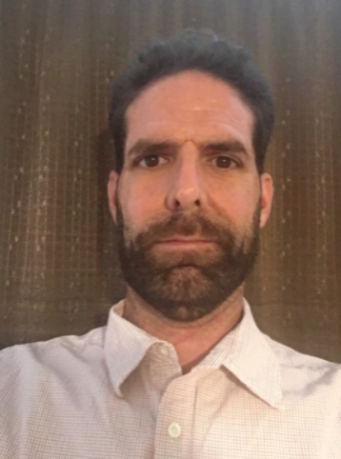
Dr. Christopher Kristich Band/General Music Teacher

Slide 2
My Contact Information
kristch1@Richmond.k12.ga.us
School Number 706-737-7288

Slide 3
Daily Schedule
9:15-11:10, Planning/Meetings
11:10-12:25, 7th Grade
12:45-2:00, 6th Grade
2:45-4:05, 8th Grade

Slide 4
CHECKOUT MY WEBSITE TO VIEW THE FOLLOWING INFORMATION
Class Syllabus/Supply List
Resources
Additional Information

Slide 5
Arrival and Dismissal
Morning Arrival
Drop off your child on Dragons Way behind the school
Morning Drop off time for car riders 8:45 A.M.
Early drop off students are unsupervised. Please remain with your child until 8:45 A.M. when teachers report for duty.
Afternoon Dismissal
Bus riders will report to bus loading zone
Walkers are dismissed from the bus loading zone where the crossing guard is located
Car Riders pick up time 4:05 p.m.

Slide 6
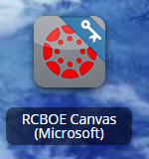
RCSS Learning Platform and Canvas
New to the Richmond County
Go to rcboe.org
Click Student
Click Launch Pad
Your child will login through Launch Pad to access RCBOE Canvas.
Click link to watch Tutorial Video
https://www.rcboe.org/Domain/16265

